Slide 1

PRESENTATION

Slide 2
CRE.THI.DEV.
CRE.THI.DEV. – Creative Thinking Development
  Not Profit Organization
  Established year : 2012
  Founder/Administrator : Dimosthenis Papakonstantinou
  Members : 9 people
  Offices : Athens, Greece

Slide 3
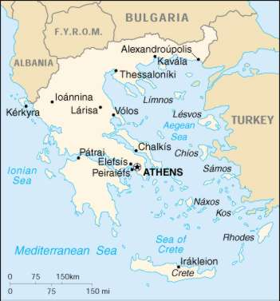
Where we are located

Slide 4

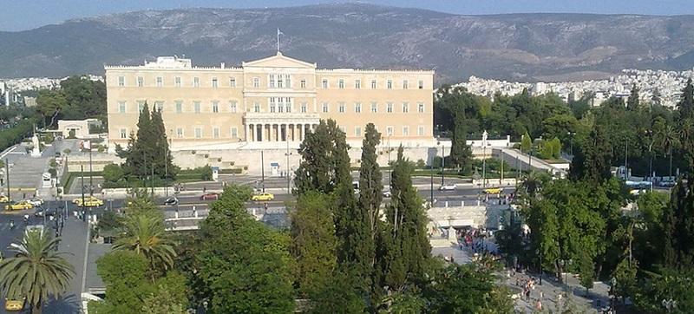
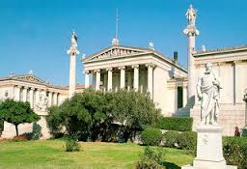


over 3,400 years history

Slide 5
Who We Are – What We Do
CRETHIDEV is a non-profit company that focuses on research, as well as development of studies and action plans, mainly in the following fields:
  local communities and local development
  life-long learning
  environmental protection
  quality
  innovation
  employment and local development
  health
  athletics
  culture

Slide 6
Areas
Knowledge
Specialization
Enterprises - mainly small and medium enterprises (leather, footwear, textile, clothing, marble, wood and furniture, food, ceramics, silver & gold, synthetic polymers)
Local, regional, national and European authorities
training, design, quality, research and innovation
athletics, cultural, transport, energy saving, environment, social policy, research and innovation, technology transfer

Slide 7
Aims
To improve networking and cooperation among local, regional, national, European authorities, organizations, business associations
To promote innovation, entrepreneurship, sustainable development and exchange of knowledge and expertise, through research and European projects
Cooperation with universities, companies, public authorities, training centers.

Slide 8
Objectives and Strengths
Special attention is paid to consolidating the skills of the young, especially those of higher education, to the demands of the labor market and motivating them to seek employment in their own region in order to promote local quality of life.
Strengths
  creative contribution
  knowledge and experience
  networks in Greece and aboard
  our people and collaborators

Slide 9
Projects

Slide 10
Previous projects
Project Title | Programme | Partners | Period
TECLO Textile and Clothing Knowledge Alliance | ERASMUS + , KA2 Knowledge Alliances | Coordinator: Link Campus University, Italy Partnership: 14 partners from 8 EU countries | 11/2014 - 10/2016
LAWPRET Local Authorities Waste Prevention Training | ΕRASMUS + KA2 – Strategic Partnership | Coordinator: ECOREC, Greece Partnership: 3 EU countries | 11/2014 - 10/2016
E-Women Innovation and Employability for Women | EEA GRANTS | Coordinator:N CSR "DEMOKRITOS“, Greece Partnership: 5 partners from Greece and Norway | 1/2016 - 03/2017

Slide 11





Current Projects
PROJECT | PROGRAMME | PARTNERS | PERIOD
INVENT Promotion of Innovation Culture in the Higher Education in Jordan | Erasmus + Capacity Building for Higher Education | Coordinator: Jordan University of Science and Technology (JUST), Jordan Partnership: 13 partners from Europe & Jordan | 10/2015 - 10/2018
FAIRHAP Fair Play and Happiness through Sports | Erasmus+ Sport | Coordinator: CRE.THI.DEV. Partnership: 5 partners from Europe | 01/2017 - 12/2018
Creative Wear Creative Clothing for the Mediterranean Space | MED project | Coordinator: Municipality of Prato, Italy Partnership: 9 partners from Europe | 11/2016 - 02/2019
FoodQA Fostering Academia-Industry Collaboration in Food Safety and Quality | Erasmus + Capacity Building for Higher Education | Coordinator: Jordan University of Science and Technology (JUST), Jordan Partnership: 13 partners from Europe and Jordan | 10/2016 - 10/2019

Slide 12



Current Projects
PROJECT | PROGRAMME | PARTNERS | PERIOD
K4F Knowledge4Foot Knowledge Platform for Transferring Research and Innovation in Footwear Manufacturing | Erasmus+ Strategic Partnership Higher Education | Coordinator: "Gheorghe Asachi" Technical University of Iaşi , Romania Partnership: 9 partners from Europe | 9/2015-8/2018 `
LEAMAN Manager in an Efficient and Innovative Leather Company | Erasmus+ Strategic Partnership | Coordinator: CTIC - Centro Tecnológico das Indústrias do Couro, Portugal Partnership: 7 partners from Europe | 9/2016-8/2018
INNOLEA Innovation for the Leather Industry in Jordan and Egypt | Erasmus + Capacity Building for Higher Education | Coordinator: National Technical University of Athens Partnership: 12 partners from Europe, Jordan and Egypt | 10/2017 - 10/2020

Slide 13


Current Projects
PROJECT | PROGRAMME | PARTNERS | PERIOD
TEXSTRA Textile Strategy for Innovative Higher Education | Erasmus+ Strategic Partneship Higher Education | Coordinator: INDCPT - Institutul National De Cercetaredezvoltare Pentru Textile Si, Romania Partnership: 10 partners from Europe | 9/2017-2/2020
SHOEMAN Manager for an Efficient and Innovative Footwear Industry | Erasmus+ Strategic Partnership | Coordinator: TASEV (Turkiye Ayakkabi Sektoru Arastirma Gelistirme Ve Egitim Vakfi), Τουρκία Partnership: 10 partners from Europe and Turkey | 9/2017-8/2020
BOOST4Shoes Boosting cross-border online sales of shoes | Erasmus+ Strategic Partnership | Coordinator: Civic Computing Limited, Ηνωμένο Βασίλειο Partnership: 7 partners from Europe | 9/2017-8/2019
CLICHA Climate Change in Agriculture | Erasmus + Capacity Building for Higher Education | Coordinator: Γεωπονικό Πανεπιστήμιο Αθήνας Partnership: 13 partners from Europe & Tunisia | 10/2017-10/2020

Slide 14



Communication
Administrator: Dimosthenis Papakonstantinou
Address: Solonos & Empedokleous, 19009 Drafi, Rafina
PO Box. : 2303
T: +30 2108047243, M: +30 6944506065
dimosthenis_p
dpapakon7@yahoo.gr
www.crethidev.com

Slide 15
Thank you for your time
.
Creative Thinking Development

