Slide 1
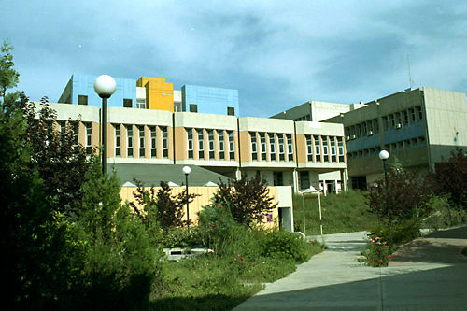
National Technical University of Athens

Slide 2
The National Technical University of Athens (NTUA) is the oldest Technical University, founded in 1837. Today, it is structured according to the continental European system for training engineers, with an emphasis on solid background. The duration of courses leading, after the acquisition of 300 credit units to a Diploma, of Master’s level, is five years.
NTUA consists of the following 8 Engineering Schools: Civil, Mechanical, Electrical, Architecture, Chemical, Rural and Surveying, Minong and Metallurgical, Naval and the School of Applied Mathematical and Physical Sciences. There are in total, 40 Departments and 193 thoroughly equipped Laboratories and Workshops in the NTUA’s Schools, dealing with specific scientific fields.

Slide 3
NTUA operates many of its Laboratories also as "service laboratories", which provide expert advice, tests and measurements and all specialized services in general, within the framework of its technological competence, which can be useful for the development of the country.
NTUA is currently estimated to have a total number of 200.000 volumes of books coming from purchases, donations and research projects, and over 80.000 volumes of scientific reviews. Books and reviews are available either from the Central Library of the Institution or from the Libraries of the Faculties, the Departments and the Labs.
At NTUA, there is appreciable know-how into all topics of Physical and Applied Sciences, with emphasis to disciplines such as Informatics, Materials, Environment etc.

Slide 4
The personnel include more than 700 people as academic staff, 140 scientific assistants and 260 administrative and technical staff. The total number of NTUA employees is about 1350. The total number of undergraduate students is about 8500 and the graduate students 1500. There are currently 19 Departmental or Inter-Departmental Postgraduate Courses, leading to the respective "Post Graduate Specialisation Diploma", with a minimum duration of 17 months. After the acquisition of the "Post Graduate Specialisation Diploma", the student can proceed towards submitting a Doctorate Thesis. The students' exchange programmes give students the opportunity to attend courses in another European country, for a period of time that can range from three months to one academic year. During their stay abroad, the students have to attend courses that correspond to the ones of their normal semester, and pass the exams for them. These courses are recognised by N.T.U.A. when the student returns to Greece.

Slide 5
The School of Chemical Engineering

Slide 6
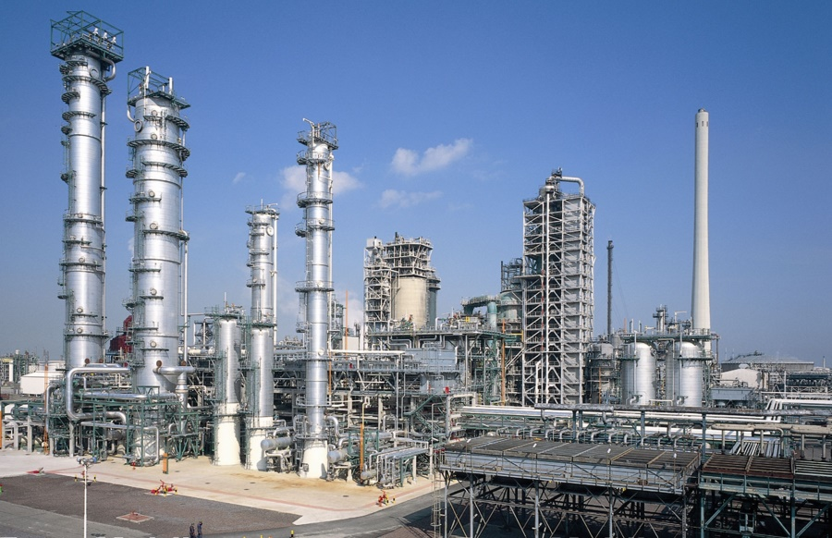
The role of Chemical Engineer in the Industry
- Technology
- Financial & - Social parameters
Raw materials
Products
Physical, Chemical and Biological Processes
Energy
By-products
Reuse Recycling
Chemical Engineers work on the synthesis, design, scale-up, automation and optimization of physical, chemical and biological processes for the transformation of raw materials to useful industrial products with the desired properties.

Slide 7
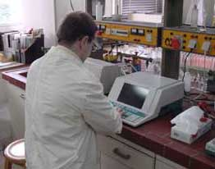
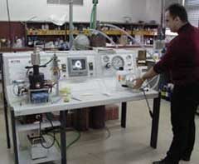
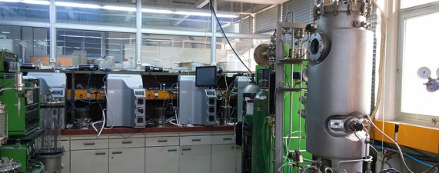
School Structure: Departments - Laboratories
Dept. of Chemical Sciences
General Chemistry Lab.
Inorganic and Analytical Chemistry Lab.
Dept. of Process Analysis and Plant Design
Industrial and Energy Economy Lab.
Organic Chemistry Lab.
Dept. of Materials Science and Engineering
Physical Chemistry Lab.
Materials Science and Engineering Lab.
Dept. of Synthesis and Development of Industrial Processes
Biotechnology Lab.
Chemical Process Engineering Lab.
Thermodynamics and Transport Phenomena Lab.
Design and Process Analysis Lab.
Polymer Technology Lab.
Fuels and Lubricants Technology Lab.
Food Chemistry and Technology Lab.
Inorganic Materials Technology Lab.
Organic Chemical Technology Lab.
15 Labs

Slide 8
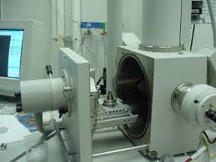
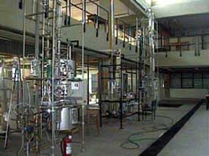
Units
Orizontal Unit
Environment and Quality of Life Lab.
Semi-Industrial Unit of Chemical Engineering
Units
Automatic Control and Informatics Unit
Unit of Environmental Science and Technology
Instrumental Methods of Analysis - Environment
Polymer Apps Group
Computational Fluid Dynamics Unit
Solar Engineering Unit
Environment and Energy Management Research Unit
Hydrocarbon and Biofuels Process Engineering Unit
Lab. Unit of Nanoengineering and Nanotechnology
….

Slide 9
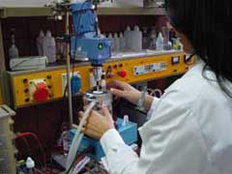
Research activities in the School of Chemical Engineering
Research activities in the School are focused on cutting edge areas, on the national and international level, with significant results in terms of handling of research projects and publication of papers in the international scale.
These achievements are due to:
- the great efforts of our Staff,
- the complete laboratory infrastructure, enhanced by the particular reputation of the School and the entire University in the field of research
- The research work is mainly produced by the contribution of young scientists, basically, PhD candidates and post-docs.
Common target of the current research attempts is the optimization of energy consumption and the sustainability practices for the environment.

Slide 10
Research activities relevant to Leather Technology
Many research projects on the treatment of Leather or its by-products, have been run in the School and numerous papers have been published. Some characteristic titles are:
Andreopoulos A.G. and Tarantili P.A., Waste leather particles as a filler for poly(vinyl chloride) plastisols, Journal of Macromolecular Science - Pure and Applied Chemistry 2000, A37(11), pp. 1353-1362
Babanas K., Tarantili P.A. and Andreopoulos A.G., Plasticized Poly(vinyl chloride) Filled with Waste Leather Particles, Journal of Elastomers and Plastics2001, 33, pp. 72-85.
Research project no 62145500 Composite Materials made of Polymers and Leather
Research project no 6231600, Leaching of collagen peptide from chrome containing leather waste, for the preparation of innovative finishing products

Slide 11
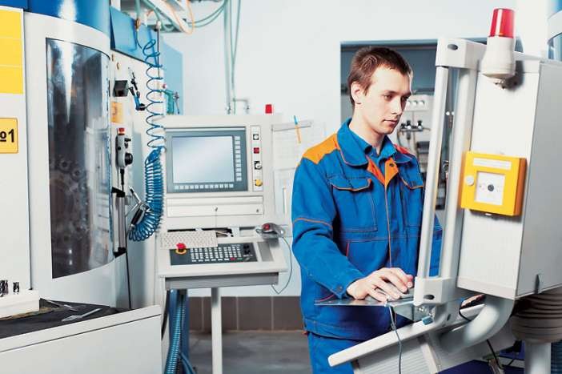
Studies at the School of Chemical Eng. NTUA
We are about to renew our under graduate Program of studies.
The current Program has the following profile:
Duration of Studies: 10 semesters
Courses
Mandatory (40)
Electives (9)
Practical training
Mandatory of Directions (5)
Diploma Thesis
Takes place in industries or research establishments for 5 weeks at the beginning of the 9th semester
It is prepared by the final semester students in a lab. and subject of their choice, under the supervision of a School member who teaches the most relevant course.
Process Engineering
Materials
Industries of Organic Chemicals- Polymers
Inorganic Processes
Food-Biotechnology

Slide 12
Teaching Procedures
Lectures of academic teachers
Tutoring (exercises etc)
Laboratory training
Educational visits
Seminars from invited speakers
Exercises to be resolved by the students
Homework and papers to be prepared by the students
Mid-term exams
Final exams
Teaching and Research staff: 63
Laboratory Teaching staff: 58
Technical Lab. Staff: 7
Secretariat: 7 + 6

Slide 13
Perspectives and the future of Chemical Engineers
- Besides the basic aim of education, which is: the design of plants, processes and products, emphasis is also given to the following:
Management and Economics
There is a recognized need of combining the engineering studies with financial and management aspect, in order to provide to the students administrative capabilities
Process control
The automation, the process control and data processing, are gaining continuously growing significance in the Chemical Industry
Quality control of products and processes
The quality control and assurance of materials and processes is an additional high priority topic for Chemical engineers.
Safety and Hygiene
Aiming at the safe design of processes and industrial plants, the prevention of industrial accidents and limitation of their impact

Slide 14
Other Options in the School of Chemical Engineering
Advisor (professor):
the main scope is to facilitate the academic performance of students and their support for efficiently facing the problems of studies and everyday’s life
Program ERASMUS+:
Provides the option of students mobility for studies or practical training to European Universities, with the appropriate scholarship

Slide 15
Post graduate programs
The Departmental or Inter-Departmental Postgraduate Courses, are leading to the respective "Post Graduate Specialization Diploma", with a minimum duration of 17 months.
Programs offered by the School:
Materials Science and Engineering
Computational mechanics
Protection of Monuments, Sites and Complexes Direction B
Programs offered by other Departments:
Automation Systems
Athens Postgraduate Program in Business Administration
Energy Production and Managent
Environment and Development
Mathematical Modeling in Modern Technologies and Economics
Chemistry Education and New Educational Technologies
Postgraduate Course on Industrial Management

Slide 16
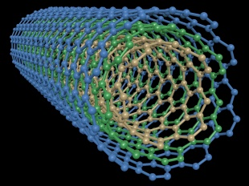
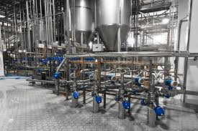
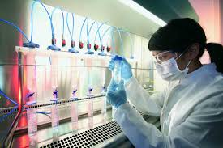
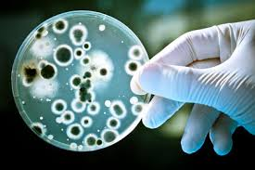
Perspectives and the future of Chemical Engineers
- New topics for growth:
Design and production of high-tech and high added value products
- structure, properties and industrial production techniques (plastics, leather etc)
- New materials (e.g. environmentally friendly)
- standardization, quality control, recycling
Food chemistry and technology
- Thermomechanical processes (drying, freezing conservation, etc)
- Upgrading of by-products of agricultural industries
Biotechnology
- Use of chemical engineering methods to the related processes
- Application in the field and food and drinks, drugs, chemicals, environment etc

Slide 17
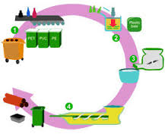
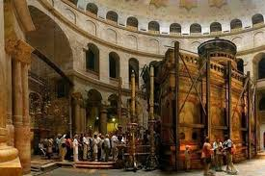
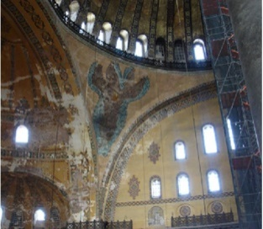
Perspectives and the future of Chemical Engineers.
- New topics for growth :
Technologies for environmental and energy management
Proper and ecological use of energy
Development of environmental friendly processes, methodologies and products
Technologies of treatment of liquid and gaseous industrial waste, materials recycling etc.
Development of technologies for conservation of cultural heritage
With emphasis on the specific aspects of conservation and promotion of monuments and other items of art.
Holy tomb in Jerusalem
Informatics and related products
The use of computers plays an increasing role on the analysis and interpretation of data, the design, control and automation of industrial plants

Slide 18
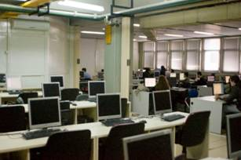
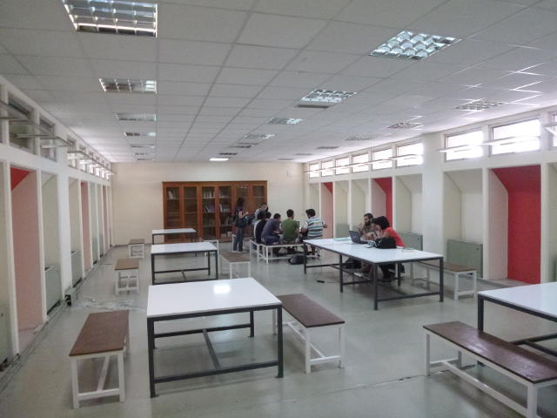
Everyday’s Life at the NTUA
Departments Computer Center
Reading Room
Central Library

Slide 19
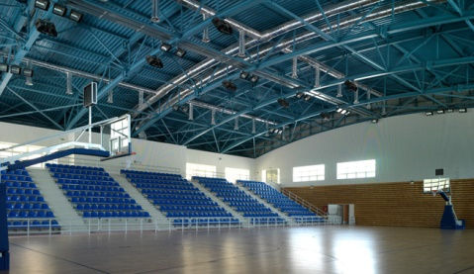
Various Activities in the NTUA
Sports Center
Mousical Sector
Dancing Sector
Theatrical group

Slide 20
National Technical University of Athens
School of Chemical Engineering

Slide 21
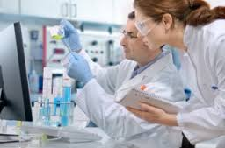
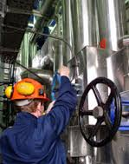
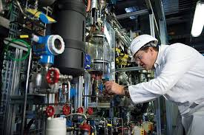
Career prospects of Chemical Engineers
Production
Quality Control
Research and Development (R&D)
Logistics
Marketing
Industry
Laboratories of measurements, Analyses and Research
Consulting – Planning and project construction
Market promotion of products and equipment of the Chemical industry
Servicing in the Public Sector
Education

